Slide 1
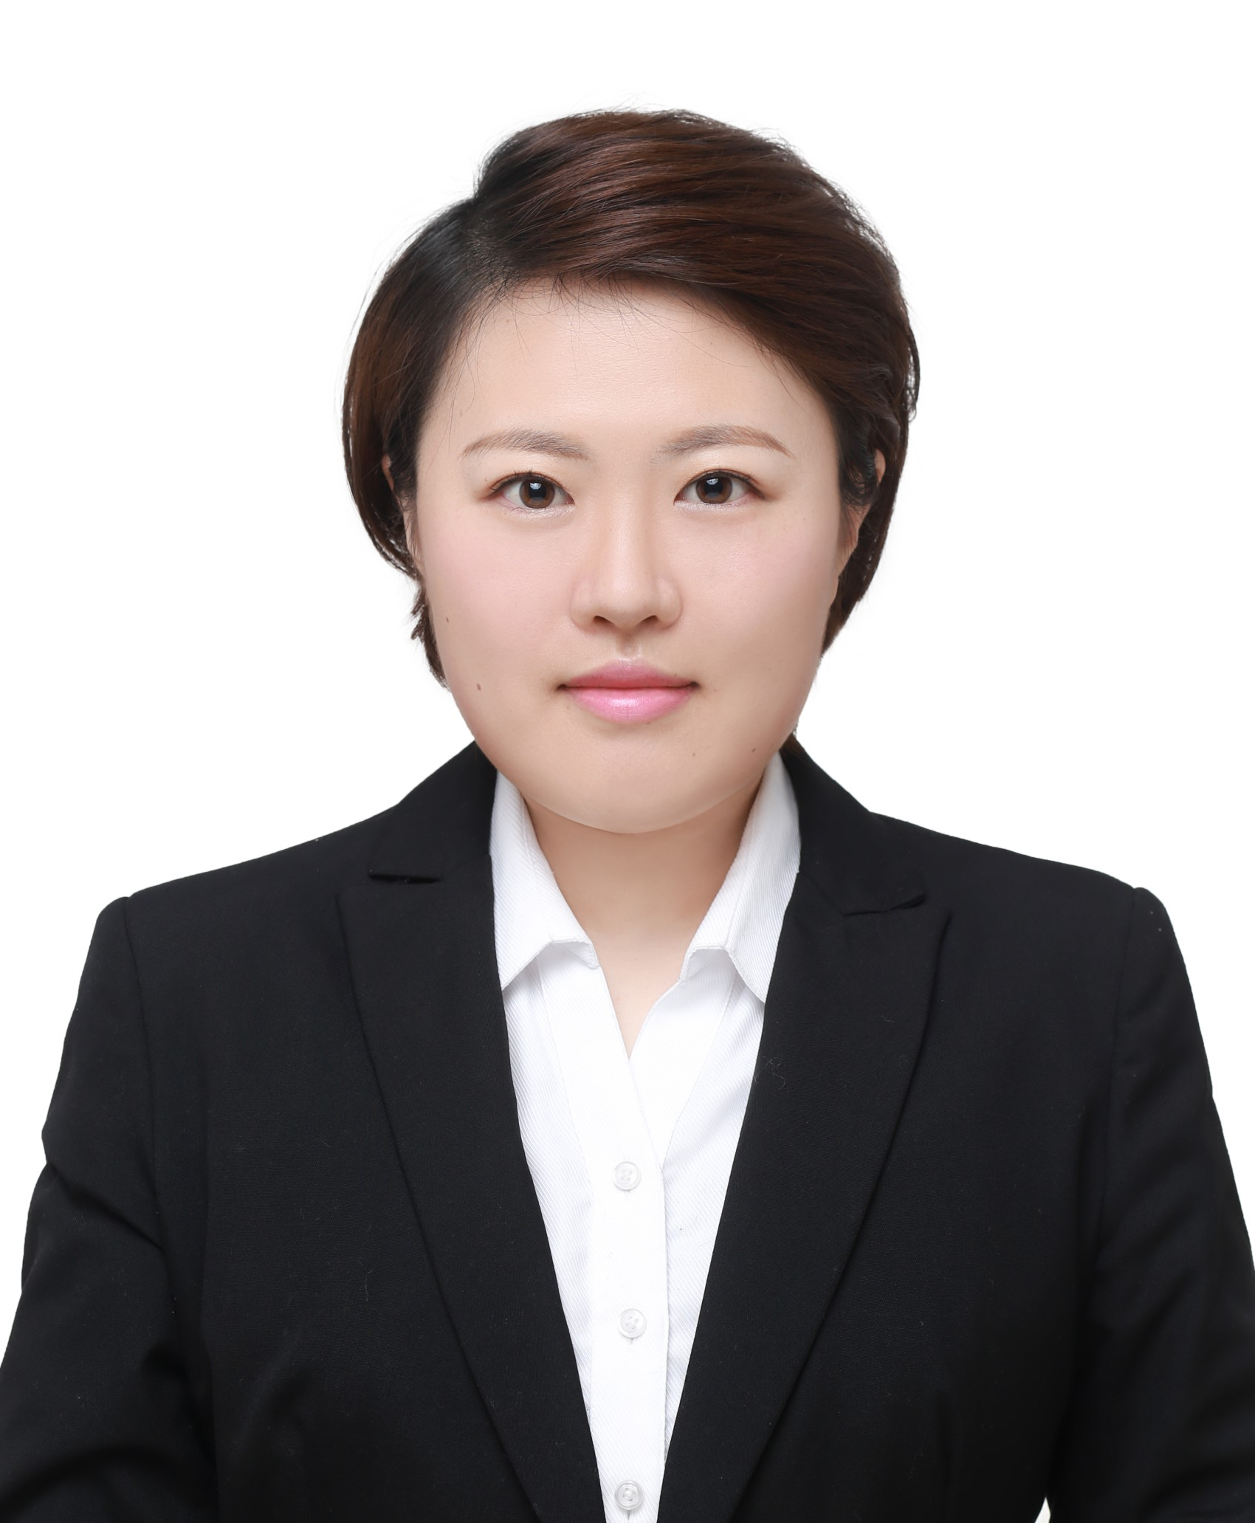
The Department of Animal Sciences
presents
Jing Yuan
Friday, May 3, 2024
2:00 p.m. CRTN 1011
Or Join Zoom Meeting
https://purdue-edu.zoom.us/j/92048844480
Meeting ID: 920 4884 4480
“Unveiling the Effects of Dietary Modulations on Avian Coccidiosis: Insights into
Gut Health and Growth Dynamics.”
Final Defense Seminar
Major Advisor: Dr. Layi Adeola
Partial Fulfillment of the Doctor of Philosophy Degree

