Slide 1
An examination of the community level dynamics related to the introduction of wind energy in Indiana

Slide 2
Outline
Discuss two studies of wind power in Indiana
Purdue extension study produced in 2020
Ongoing research paper written with Claire Nguyen

Slide 3
Purdue Extension study
Conducted by multi-disciplinary team from…
Purdue Extension - Community Development
Purdue Center for Regional Development
Purdue Department of Agricultural Economics
Purdue student involvement
Commissioned by Land and Liberty Coalition, Indiana Conservative Alliance for Energy

Slide 4
Motivation
Indiana’s first counties to accept wind power - Benton and White Counties - have accepted even more turbines over time.
But many other Indiana counties have sought to restrict utility scale wind power
The primary goal of the study was to understand the dynamics within counties that lead to a decision to support or oppose utility-scale wind generation
The study also reviewed…
the history and geography of utility-scale wind power in Indiana, and
the academic literature on the effect wind energy generation on the local economies of counties that accepted wind.

Slide 5
Broad lessons
Technological innovation has meant that the industry is now economically viable in many counties across the state.
Counties have used their planning authorities to block new investments
There are sizable economic benefits to landowners, employees, and county governments.
Detailed data from Benton and White counties illustrate the form and scale of effects on public finances.
Our listening sessions were less effective than hoped because of coronavirus.
Respondents from Benton and White County discussed many of the changes that the wind industry had brought to their counties.

Slide 6
Table 1. Operational utility-scale wind farms in Indiana
Project name | County | Nameplate Capacity (MW) | Turbine count | Year online | Hub Height (m)
Benton County Wind Farm | Benton | 130.5 | 87 | 2008 | 80
Fowler Ridge | Benton | 301.3 | 162 | 2009 | 80
Fowler Ridge | Benton | 99 | 60 | 2009 | 80
Fowler Ridge | Benton | 200 | 133 | 2009 | 80
Hoosier | Benton | 106 | 53 | 2009 | 80
Meadow Lake Wind Farm | White | 199.65 | 121 | 2009 | 80
Meadow Lake Wind Farm | White | 98.7 | 47 | 2010 | 80
Meadow Lake Wind Farm | White | 99 | 66 | 2010 | 80
Meadow Lake Wind Farm | White | 103.5 | 69 | 2010 | 80
Wildcat I | Madison, Tipton | 202.5 | 125 | 2012 | 100
Headwaters | Randolph | 200 | 100 | 2014 | 95
Amazon Wind Farm (Fowler Ridge) | Benton | 149.5 | 65 | 2015 | 80
Bluff Point | Jay, Randolph | 119.7 | 57 | 2017 | 94
Meadow Lake Wind Farm | White | 100 | 50 | 2017 | 95
Meadow Lake Wind Farm | White | 200.4 | 61 | 2018 | 105
Jordan Creek Wind Farm | Warren | 402 | 150 | 2020 | 89, 80
Rosewater | White | 103 | 26 | 2020 | 105
Bitter Ridge | Jay | 147 | 52 | 2020 | 89
Headwaters II | Randolph | 191 | 53 | 2021 | 105
Source: Science for a Changing World, AWEA Wind Project Mapping Portal, the US Wind Turbine Database. Retrieved from https://eerscmap.usgs.gov/uswtdb/viewer/#6.3/37.778/-87.597, http://gis.awea.org/arcgisportal/apps/webappviewer/index.html?id=eed1ec3b624742f8b18280e6aa73e8ec

Slide 7
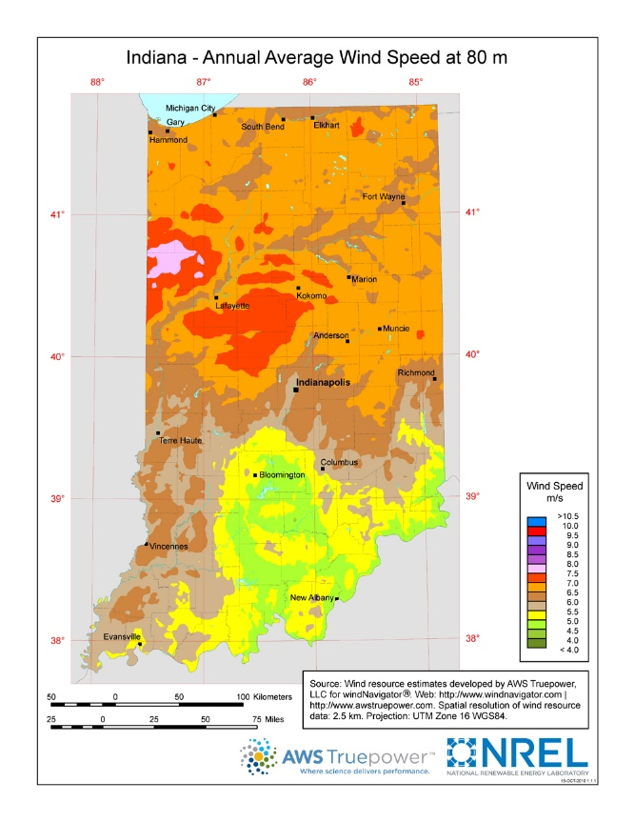
Average wind speeds in Indiana at an 80-meter height
Pink area reflects locations with average wind speeds
of 7.5 meters per second, or more.
Source: https://windexchange.energy.gov/maps-data/40 using data from NREL

Slide 8
Table 1. Operational utility-scale wind farms in Indiana
Project name | County | Nameplate Capacity (MW) | Turbine count | Year online | Hub Height (m)
Benton County Wind Farm | Benton | 130.5 | 87 | 2008 | 80
Fowler Ridge | Benton | 301.3 | 162 | 2009 | 80
Fowler Ridge | Benton | 99 | 60 | 2009 | 80
Fowler Ridge | Benton | 200 | 133 | 2009 | 80
Hoosier | Benton | 106 | 53 | 2009 | 80
Meadow Lake Wind Farm | White | 199.65 | 121 | 2009 | 80
Meadow Lake Wind Farm | White | 98.7 | 47 | 2010 | 80
Meadow Lake Wind Farm | White | 99 | 66 | 2010 | 80
Meadow Lake Wind Farm | White | 103.5 | 69 | 2010 | 80
Wildcat I | Madison, Tipton | 202.5 | 125 | 2012 | 100
Headwaters | Randolph | 200 | 100 | 2014 | 95
Amazon Wind Farm (Fowler Ridge) | Benton | 149.5 | 65 | 2015 | 80
Bluff Point | Jay, Randolph | 119.7 | 57 | 2017 | 94
Meadow Lake Wind Farm | White | 100 | 50 | 2017 | 95
Meadow Lake Wind Farm | White | 200.4 | 61 | 2018 | 105
Jordan Creek Wind Farm | Warren | 402 | 150 | 2020 | 89, 80
Rosewater | White | 103 | 26 | 2020 | 105
Bitter Ridge | Jay | 147 | 52 | 2020 | 89
Headwaters II | Randolph | 191 | 53 | 2021 | 105
Source: Science for a Changing World, AWEA Wind Project Mapping Portal, the US Wind Turbine Database. Retrieved from https://eerscmap.usgs.gov/uswtdb/viewer/#6.3/37.778/-87.597, http://gis.awea.org/arcgisportal/apps/webappviewer/index.html?id=eed1ec3b624742f8b18280e6aa73e8ec

Slide 9
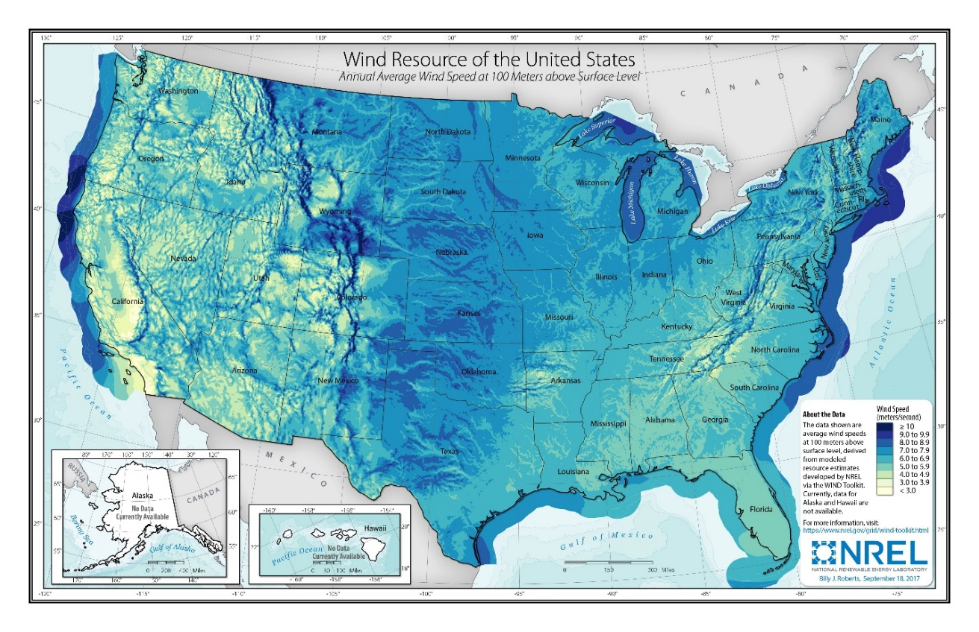
Figure 2. Wind resources of the United States at the height of 100 meters
Source: https://windexchange.energy.gov/maps-data/324 using NREL data.

Slide 10
Key takeaway: Spreading economic viability of wind power

Slide 11
Regional electricity markets in the United States
Source: https://www.ferc.gov/electric-power-markets

Slide 12
Role of county-level policies
Technological change has made utility-scale wind power economically viable in parts of Indiana that could not host it earlier.
The primary constraint on the growth of utility-scale wind power in Indiana appears to be county-level policies that restrict development.
Planning and zoning policies impose restrictive “set-back” policies as well as restrictions on the height of turbines.

Slide 13
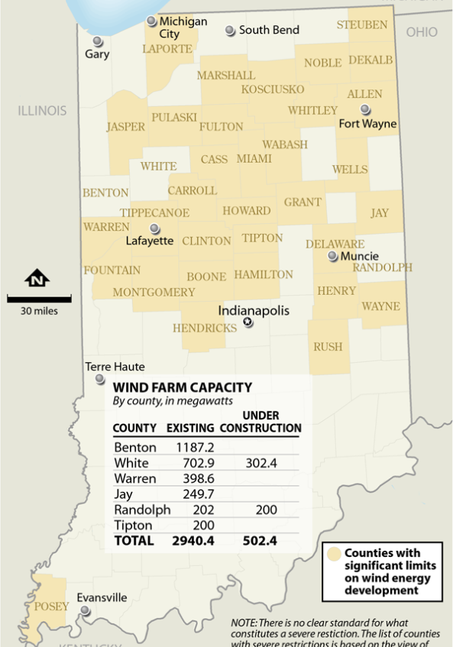
County restrictions on wind energy in Indiana
Source: https://insideclimatenews.org/news/30032021/indiana-wind-energy/

Slide 14
Measuring economic effects: input-output analysis vs econometrics
Many estimates of the industry’s economic impact are input-output studies
Forward looking
Attempt to capture “upstream” effects such as manufacturing of turbines and components
Gross, not net, calculations. Ignores feedback effects.
These are overstated, and not relevant to rural economic development questions.
At the county level, we can now make statistical comparisons of economic outcomes in counties that did and did not get wind investments (econometrics)
More appropriate for a study with a county-level focus
Can look at actual outcomes, rather than projections
Measures net effects
Acknowledges statistical uncertainty.

Slide 15
Results from academic studies using statistical analysis
Persuasive statistical evidence that utility scale wind energy…
Raises average incomes in a county (Brown, et al 2012; De Silva, et al 2016)
Increases local tax base and tax revenue collection (De Silva, et al 2016)
Improves yields of corn and other field crops (Kaffine, 2019)
Net effects of the industry on employment are not statistically significant (Brown et al 2012; De Silva et al 2016)
Statistical evidence on the effects on nearby property values is mixed
No statistically significant effect on local property values in US (Hoen, et al 2015)
Negative effects likely no more than 3-4 percent
Stronger and statistically significant evidence that property values are affected in Denmark (Jensen, et al 2014)
Evidence from Canada suggests that the impact of wind energy on property values depends upon community attitudes (Vyn, 2018)

Slide 16
Table 6. Implied impacts on per capita income and employment
County | Capacity installed (MW) | Population (2018) |  | Brown et al. (2012) estimates |  | De Silva et al. (2015) estimates
 |  |  |  | Per capita income ($) | Employment | Per capita income ($) | Employment
Benton | 986 | 8,653 | Mean estimate | 1270 | 473 | 303 | 1163
 |  |  | 95% interval | [62, 2480] | [-69, 1016] | [72.5, 533] | [-247, 2564]
Jay | 120 | 20,764 | Mean estimate | 64.5 | 58 | 15.4 | 142
 |  |  | 95% interval | [3.14, 126] | [-8.4, 124] | [3.7, 27] | [-30, 312]
Madison, Tipton | 203 | 144,770 | Mean estimate | 15.63 | 97 | 3.73 | 240
 |  |  | 95% interval | [1, 31] | [-14, 210] | [0.9, 6.6] | [-51, 528]
Randolph | 200 | 24,850 | Mean estimate | 90 | 96 | 21.4 | 236
 |  |  | 95% interval | [4.4, 175] | [-14, 206] | [5.12, 38] | [-50, 520]
White | 801 | 24,133 | Mean estimate | 371 | 385 | 88.2 | 945
 |  |  | 95% interval | [18, 722] | [-56, 825] | [21, 155] | [-200, 2083]

Slide 17
Presumed channels of effects on average incomes
Lease payments to local landowners
$3000-$6000 per megawatt of installed capacity.
Locals in BC and WC use $4000/MW as a working figure.
$6000 - $12000 per turbine
Wind industry jobs pay much more than the average job in these areas
Turbine technicians earn approx. $60,000 per year
Tax and other payments to local governments improve services, reduce tax burden on residents
In 2019 the wind industry paid….
Benton County $4.3 million in property taxes, $492 per citizen
White County $2.3 million, $94 per citizen.
Other large payments include economic development payments, as well as payments to maintain and improve roads.
Other possible channels (e.g. increase in local retail spending), but less direct and more difficult to measure

Slide 18
How do counties distribute these funds?
Spending and tax relief are often targeted at localities nearest the turbines.
Perhaps one reason that effects on property values are mitigated in the U.S.
Table 5. Average property tax rates for Benton County towns and townships, 2006- 2019
 | 2006 | 2007 | 2008 | 2009 | 2010 | 2011 | 2012 | 2013 | 2014 | 2015 | 2016 | 2017 | 2018 | 2019
Avg all | 2.49 | 2.87 | 2.64 | 2.05 | 2.10 | 1.96 | 1.81 | 1.60 | 1.68 | 1.57 | 1.56 | 1.61 | 1.61 | 1.66
Avg tws | 2.20 | 2.53 | 2.31 | 1.59 | 1.58 | 1.44 | 1.30 | 1.12 | 1.07 | 0.97 | 0.99 | 0.99 | 1.00 | 1.05
Avg towns | 3.01 | 3.49 | 3.25 | 2.90 | 3.05 | 2.92 | 2.75 | 2.49 | 2.79 | 2.67 | 2.63 | 2.77 | 2.73 | 2.77
Notes: Average property tax rates for all Benton County tax units, for townships (tws) and for towns. Data is publicly available from the Benton County Assessor’s office. Property tax rates rounded to two decimal places here for the purpose of brevity.
White County also targets tax relief towards the affected townships.

Slide 19
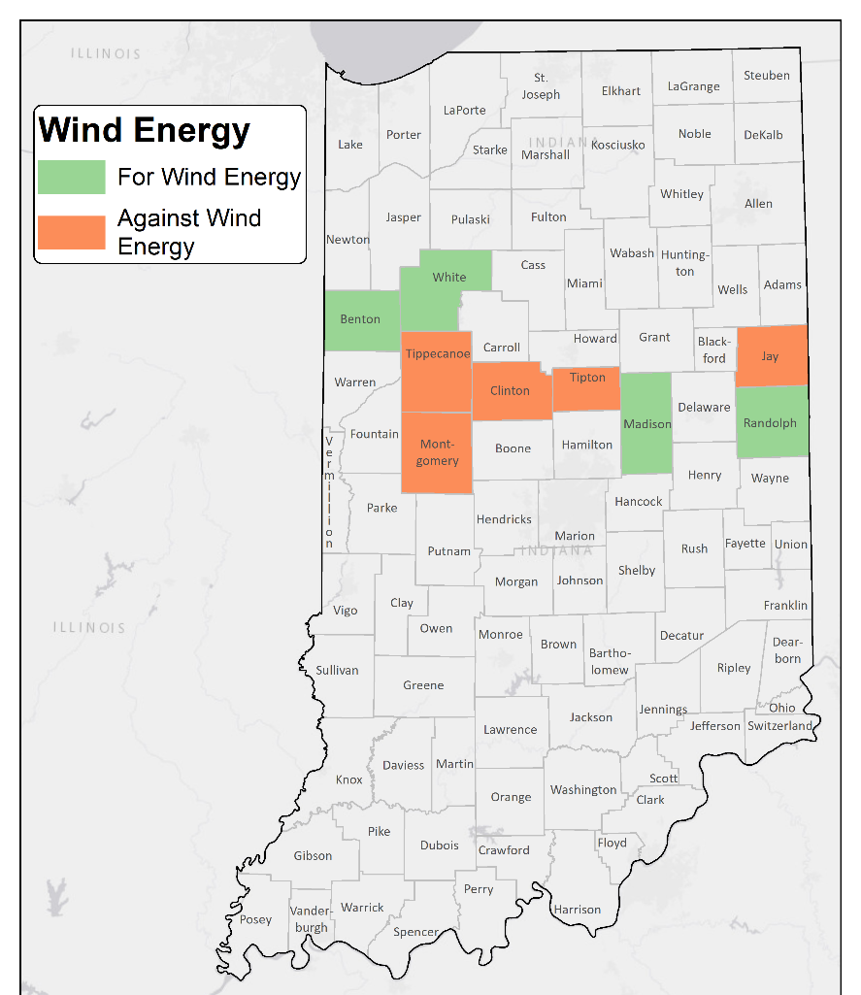
Section III. Socio-economic profile of counties with policies that favor and restrict wind power.
Selection of four counties that favor local siting of wind power and five that oppose it.
Relative to the counties that oppose new wind power, counties accepting wind have
lower population densities,
greater declines in population,
more dependence on agriculture,
lower average incomes,
higher rates of commuting to work outside the county.

Slide 20
On-line listening sessions
Originally planned as focus groups in each of four counties (Benton, White, Jay and Randolph).
Moved on-line due to Covid-19 restrictions.
Extensive invites, but no participation from Jay and Randolph counties, where wind energy is more controversial.
We held sessions with participants from Benton and White counties.
Responses were anonymous to allow participants to speak freely.
Explored impacts of wind on seven forms of “community capital”

Slide 21
Online listening and the 7 community capitals
Natural Capital
BC: “It has changed the landscape. Some people think it's wonderful and some people don’t.”
WC: “We cut out one acre per turbine with wind energy, the footprint doesn't take an entire acre obviously and the farmer can farm practically right up to the footprint. So no, I don't feel like it is a detriment to farming.”
Human Capital
BC: “Very, very well-paying jobs with great benefits. That's what I said, it literally changed the lives of many of our people in our county.”
Social Capital…

Slide 22
Online listening and the 7 community capitals
Political Capital…
Cultural Capital…
Financial Capital
WC: “There are a couple of townships, those Southwest townships, the wind energy pays almost half of the property taxes that are collected in those townships.”
Built Capital
BC: “Wind energy has helped us with our schools, our roads, our basically businesses and we've had a lot of new construction in our county.”
BC: “I feel like we are at capacity or close with wind. We've been in almost every area that I feel like we can. 622, I believe turbines right now actively developing a new project that's being constructed right now in Benton and Warren counties.”

Slide 23
Ongoing work:
Hillberry, Russell and Nhu “Claire” Nguyen, 2021, “Renewable resource rents, taxation and the effects of wind power on rural communities,” in progress.
Builds a (general equilibrium) simulation model that investigates…
a) the arrival of wind power on the economies of Benton and White Counties
b) the consequences of resource rent taxes on these counties economies.
Case study of the effect of the turbines that were installed in Benton and White Counties during 2007-2010.

Slide 24
Motivating idea: Taxes or other revenues are critical for widely shared local benefits
“Industries based on cheap sources of energy or producing fuels and minerals are typically capital-intensive and…have limited scope for local purchase of supplies. Hence, whatever national benefit is to be derived from them must come mainly through taxation. The central task of economic management in the resource-based industries is thus to maximise the contribution that these industries make to government revenue.” Garnaut and Clunies Ross (1975)
“Never seen (a wind) project die because of tax structure.” Anonymous wind developer quoted in Mills and Rozuno (2018)

Slide 25
Table 1. Demographic and economic characteristics of case study counties
 | Benton County, IN |  | White County, IN
 | Level | Percentile in US | Level | Percentile in US
Personal income (2007) | $292 million | 0.233 | $778 million | 0.512
Population (2007) | 8,805 | 0.190 | 24,762 | 0.485
Per capita income (2007) | $33,190 | 0.665 | $27,802 | 0.566
Population density (2000) | 23.13 persons / sq mile | 0.320 | 49.92 persons / sq mile | 0.550
Net cash farm income (2007) | $52.3 million | 0.869 | $72.9 million | 0.928
Corn sales (2007) | $84.9 million | 0.963 | $103.4 million | 0.979
Soybean sales (2007) | $44.3 million | 0.967 | $36.7 million | 0.932
Nameplate capacity of generating assets (2011) | 840.55 MW | 0.989 | 500.85 MW | 0.960
Estimated value of electricity produced (2011) | $150 million | n/a | $100 million | n/a

Slide 26
Defining “Economic Rent”
Different from payment to live in a house or use land, as in standard English
‘Economic rent’ is broadly defined as income derived from ownership or control over a limited asset or resource. Such income is attained without any expenditure or effort… in excess of their opportunity cost. (Source: UC London web site)
We believe there are economic rents in the wind sector, or at least there were in 2007-2010.
Sources of economic rent
Wind is an unpaid factor of production
Generous federal subsidies
Economic theory says that it is possible for economic rents to be taxed without discouraging participation (e.g. by developers and landowners).
But how big are the rents in this situation?

Slide 27
Results
We estimate that approximately $5.86 per MwH of output from this generation of turbines is rent (supernormal profit)
These investments would have occurred with $5.86 less profit per MwH
$4.86 less to outside capital. $1 less to landowners
We consider consequences of efficient taxation of rents.
County-wide benefits without tax: BC 1%, WC small fraction of 1%
Benefits with tax: BC 5%, WC 1%
Annual tax revenues from 99% tax on rents:
BC $16,406,663; WC $9,800,850
Increase in weekly salary if rent taxes paid to labor: BC $77, WC $14.5

Slide 28
Extensions/Caveats
Full taxation not incentive compatible. Landowners worse off
Maximal incentive compatible tax rate in BC 65%, WC 75%
Effects of taxes on outcomes still quite large
We consider a number of alternative scenarios like these.
Rents are much smaller in the current environment
Lower electricity prices, federal subsidies, …. but improved technology.
Both electricity prices and subsidies may be rising again.

Slide 29
Takeaways
Local restrictions are the binding constraint on investments in Indiana, not taxes.
Taxation is feasible, but must respond to conditions.
More broadly shared benefits might generate broader support for the turbines.
Taxation is not the only way to get there
Developers could be more generous
Local governments could negotiate for larger payments up front
Could Public Utilities Commission be tasked with analytical support for local taxation?

Slide 30
Thank you…..Questions?

