Slide 1
https://youtu.be/H6n3iNh4XLI

Slide 2
Awareness Workshop:
Hidden Bias of Good People
Sharon Williams, 765-494-7398, ssw@purdue.edu
Human Resources
Ayanna Bledsoe, 765-496-3916, aabledso@purdue.edu
Office of Multicultural Programs

Slide 3
The Look:
https://www.youtube.com/watch?v=aC7lbdD1hq0
Notes:
Have Kleenex

Slide 4
Workshop Goals and Objectives:
Raise your awareness of “Hidden Biases” that we all have.
Provide a space to dialogue about bias and potential unintended consequences – Not here to blame anyone (white males) or to make anyone cry!
Share the complexity of hidden bias using research and real world examples.
Share additional resources for personal diversity development.
Examine your beliefs, values and assumptions regarding cultural differences and social group memberships and experiences.
Notes:
Have Kleenex

Slide 5
Brave Space
Discussing anything related to diversity, bias, and stereotype can be very personal.
We’ll be respectful – not here to embarrass anyone.
This is a good space to ask and share.
Smiles are okay – learning should be enjoyable.
Confidentiality - take the lesson learned not the story told.

Slide 6


Methodology used in preparation for today
We respect you to much not to have research:
Work from the Kirwan Institute, The Ohio State University
Dr. Margo Monteith, Psychology Department, “Implicit Bias”
Microaggressions, Dr. Derald Wing Sue, Columbia University
Harvard Project – Implicit Bias
Blindspot – Hidden Biases of Good People, Banaji, Breenwald
Thinking, Fast and Slow – Daniel Kahneman
Notes:
Share with the participants we are borrowing from these sources to ensure fact based approach. We also understand that facts and research are only discussion points to find common ground. Not here to make people change their thinking, only want to expand the conversation. Okay to be skeptical

Slide 7
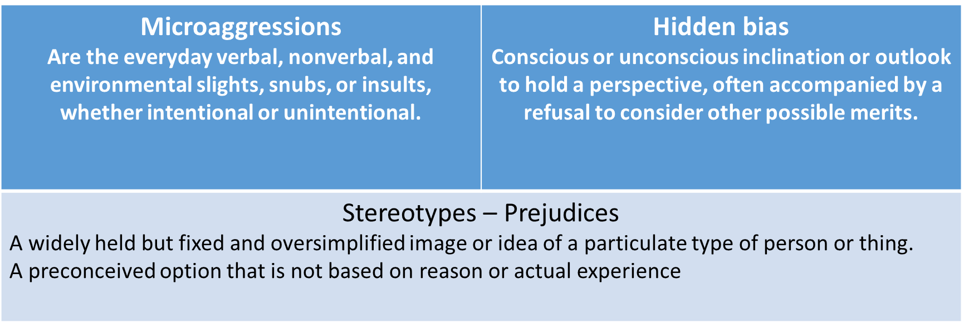
Definitions
Where Stereotypes, Micoaggressions, Bias & Prejudice cross paths
Notes:
Review the definitions. Explain connection to Blindspot book and the term Mindbugs – just sharing latest research.

Slide 8
Going to show you two videos
These will be the content for our first small group discussion

Slide 9
Ted Talk on Unconscious Bias
A brief tutorial
https://icelebratediversityblog.com/2015/03/05/watch-this-great-ted-talk-on-unconscious-bias-brief-but-impactful/
Notes:
Start the video – STOP at the 4:23 mark
https://www.youtube.com/watch?v=vUdkHpZIGGQ

Slide 10
Blind date video – couple in a car
Another perspective
https://www.youtube.com/watch?v=CD29UmTyzmk
In your groups – please discuss:
Your reactions to the videos
Did the Ted Talk surprise you?
\What about the Blind Date?
Thoughts?

Slide 11
Unconscious Hidden Bias
CNN news article November, 2015
Who are your three best friends? Similar or totally different from you?
Do we automatically exclude certain neighborhoods as places we might shop, live or “go out”?
What makes a neighborhood unsafe or sketchy?
Do you “only date” or marry or partner with a certain type person?
Do you have a “gay friend”? Someone with a disability?
Words and phrases can have intentional and unintentional consequences, beyond being politically correct.
These are all complicated choices and factors we might
consciously or unconsciously be making
Notes:
1:56 3:06
**things to think about**
Picture your three BFFs, excluding your romantic partner. Chances are, they're the same race as you, according to various surveys. In fact, a CNN/Kaiser Foundation poll released this week found that despite the millennial reputation for inclusiveness, young white Americans don't have especially multicultural friend groups.
Younger whites are almost twice as likely as Hispanics and blacks to say they socialize mostly within their own race (68% of whites age 18-34 say they overwhelmingly associate with other whites, compared with 37% of Hispanics and 36% of blacks of the same age); the gap is just as wide on where young whites choose to live.
According to the CNN/Kaiser poll, a majority of whites (69%) say the people they live around are mostly of the same race as them, while Hispanics predominantly say they live around people of other races (59%). Blacks are split, with 51% saying they live around people of other races and 41% saying they live around mostly other black people.
n 2013, about 12% of new marriages in the U.S. were between spouses of different races, according to a Pew Research analysis of American Community Survey data.
Many factors play into our choice of potential partners: religion, social values, political views, physical appearance. Or, maybe it "just happened," and you fell in love.
A master status is when one part of a person's social identity, such as being black, disabled, gay or Muslim, becomes the central and most important aspect of who that person is.
"This is typically a label conferred on an individual, and it becomes subconsciously linked to the person by those around him or her," Gallagher said.
It's hard to say whether it's linked to hidden bias, especially since labeling someone might be a conscious, well-meaning effort to identify that person from others with their most distinctive quality.
But consider the reverse: How often do you refer to someone as your "straight white friend"?

Slide 12
Questions – thoughts so far . . .

Slide 13

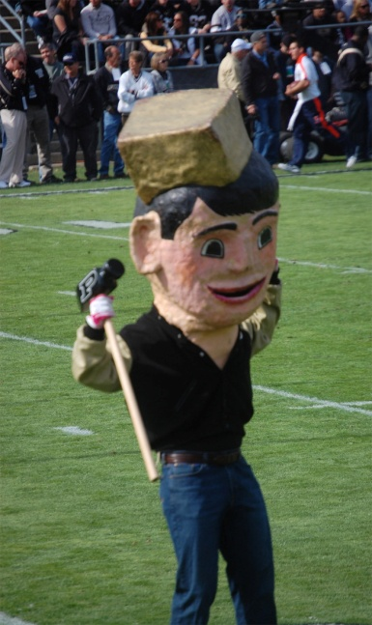
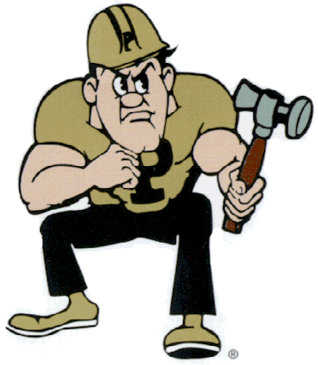
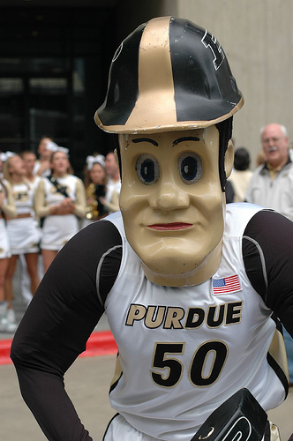
Purdue Pete – The Athletic Mascot
This may be challenging, frustrating for some or even eye opening
What do they have in common?
Notes:
Based on limited research and institutional memory, there has never been a woman student as Purdue Pete? A minority student? Is this a hidden bias? At Notre Dame there was an African American “Irish mascot”, rumor has it, the teams lost that year and there has not been one since. To further your discussion, in the Marching Band, there has only been two female Band Majors in the history of the band? Bias? Coincidence?

Slide 14
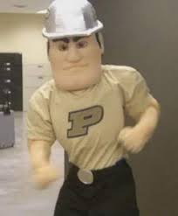
Purdue Pete Discussion
In small groups – please discuss and vote:
Any hidden bias related to Purdue Pete?
Should we care if we have never had a female Purdue Pete?
Should it matter that we have not had a person of color Purdue Pete?
Just leave Purdue Pete alone!
Does his image represent all of Purdue?
Another example of “political correctness”
Notes:
Have the audience
Based on limited research and institutional memory, there has never been a woman student as Purdue Pete? A minority student? Is this a hidden bias? At Notre Dame there was an African American “Irish mascot”, rumor has it, the teams lost that year and there has not been one since. To further your discussion, in the Marching Band, there has only been two female Band Majors in the history of the band? Bias? Coincidence?

Slide 15
Unconscious Hidden Bias – Exercise
Research and work done by Dr. Derald Wing Sue
Microagrressions – Can be everyday verbal, nonverbal and environmental slights, snubs, or insults. Can be intentional or unintentional.
We understand this research is not universally accepted as valid.
Our Bias - words and phrases can have intentional and unintentional consequences, beyond being politically correct.
In small groups, you will do a matching exercise.
Notes:
1:56 3:06
Picture your three BFFs, excluding your romantic partner. Chances are, they're the same race as you, according to various surveys. In fact, a CNN/Kaiser Foundation poll released this week found that despite the millennial reputation for inclusiveness, young white Americans don't have especially multicultural friend groups.
Younger whites are almost twice as likely as Hispanics and blacks to say they socialize mostly within their own race (68% of whites age 18-34 say they overwhelmingly associate with other whites, compared with 37% of Hispanics and 36% of blacks of the same age); the gap is just as wide on where young whites choose to live.
According to the CNN/Kaiser poll, a majority of whites (69%) say the people they live around are mostly of the same race as them, while Hispanics predominantly say they live around people of other races (59%). Blacks are split, with 51% saying they live around people of other races and 41% saying they live around mostly other black people.
n 2013, about 12% of new marriages in the U.S. were between spouses of different races, according to a Pew Research analysis of American Community Survey data.
Many factors play into our choice of potential partners: religion, social values, political views, physical appearance. Or, maybe it "just happened," and you fell in love.
A master status is when one part of a person's social identity, such as being black, disabled, gay or Muslim, becomes the central and most important aspect of who that person is.
"This is typically a label conferred on an individual, and it becomes subconsciously linked to the person by those around him or her," Gallagher said.
It's hard to say whether it's linked to hidden bias, especially since labeling someone might be a conscious, well-meaning effort to identify that person from others with their most distinctive quality.
But consider the reverse: How often do you refer to someone as your "straight white friend"?

Slide 16


Theme/Microaggression |  |  | Intended or Unintended Message
1. Alien in your own land When Asian Americans and Latino Americans are assumed to be foreign-born: | “Where are you from” “Where were you born” “You speak good English” | ( ) | You are a criminal You are going to steal/You are poor/ You do not belong. You are dangerous.
2. Ascription of intelligence Assigning intelligence to a person of color on the basis of their race: | “You are a credit to your race.” “You are so articulate.” Asking an Asian person to help with a math or science problem | ( ) | Denying a person of color’s racial/ethnic experiences. Denying the individual as a racial/cultural being.
3. Color Blindness Statements that indicate that a white person does not want to acknowledge race: | “When I look at you, I don’t see color.” “America is a melting pot.” “There is only one race, the human race.” | ( 1 ) | You are not American. You are a foreigner.
4. Criminality/assumption of criminal status A person of color is presumed to be dangerous, criminal, or deviant on the basis of their race: | A White man or woman clutching their purse or checking their wallet as a Black or Latino approaches or passes A store owner following a customer of color around the store | ( ) | People of color are generally not as intelligent as Whites. All Asians are intelligent and good in math/sciences.
5. Denial of individual racism A statement made when Whites deny their racial biases: | “I’m not racist. I have several Black friends.” “As a woman, I know what you go through as a racial minority.” | ( 5 ) | I am immune to racism because I have friends of color. Your racial oppression is no different than my gender oppression. I can’t be a racist. I’m like you.
6. Myth of meritocracy Statements which assert that race does not play a role in life successes: | “I believe the most qualified person should get the job.” “Everyone can succeed in the society, if they work hard enough.” | ( ) | People of color are given extra unfair benefits because of their race. People of color are lazy and/or incompetent and need to work harder.
7. Pathologizing cultural values/communication styles The nation that the values and communication styles of the dominant/White culture are ideal: | Asking a Black person: “Why do you have to be so loud/animated? Just calm down.” To an Asian or Latino person: “Why are you so quiet? We want to know what you think. Be more verbal. “Speak up more.” | ( ) | People of color are servants to Whites. They couldn’t possibly occupy high-status positions. You are likely to cause trouble and/or travel to a dangerous neighborhood.
8. Second-class citizen Occurs when a white person is given preferential treatment as a consumer over a person of color: | Person of color mistaken for a service worker Having a taxi cab pass a person of color and pick up a White passenger | ( ) | Male experience is universal. Female experience is meaningless.
9. Use of Sexist/ Heterosexist Language Terms that excludes or degrades women and LGBT persons: | Use of the pronoun “he” to refer to all people. | ( 7 ) | Assimilate to dominant culture. Leave your cultural baggage outside.
Notes:
1:57 3:07

Slide 17
Notes:
2:03 3:13

Slide 18
Going to show you two videos
This will lead us to another small group discussion
Notes:
Start the video – STOP at the 4:23 mark

Slide 19
Verizon TV Ad
https://www.youtube.com/watch?v=glK9MygRQ8M#t=1.360042
Notes:
We are not suggesting this test may have had some bias – only using for discussion purposes
Extra video: https://www.youtube.com/watch?v=PdhzZ56D4Kc

Slide 20
Kids Drawing
http://creativity-online.com/work/inspiring-the-future-redraw-the-balance/45935

Slide 21
Discussion
Please focus on the following:
In the Verizon ad, where you aware of the statistics? Should we “steer” young girls in any direction?
What about the “kids drawing” video?
Any other thoughts to share with your small group on either video?
Any possible connections to your interactions, teaching, or research?

Slide 22
Questions – thoughts . . .

Slide 23
These videos are more a little more serious
This will lead us to another small group discussion
Notes:
Start the video – STOP at the 4:23 mark

Slide 24
Updated doll experiment
https://www.youtube.com/watch?v=ybDa0gSuAcg
Notes:
We are not suggesting this test may have had some bias – only using for discussion purposes. This experiment was first conducted in the 1950”s

Slide 25
What does my headscarf mean to you?
https://www.youtube.com/watch?v=18zvlz5CxPE&t=15s
Notes:
We are not suggesting this test may have had some bias – only using for discussion purposes. This experiment was first conducted in the 1950”s

Slide 26
Discussion
Please focus on the following:
In the Doll experiment, were you surprised? Was there bias in the experiment? Any feelings that might show up in your everyday lives? Did you detect any bias?
Lastly, opinions on the Wearing the Headscarf?
Any other thoughts to share with your small group on either video?

Slide 27
Thinking Fast and Slow
Two systems at work in our minds
System 1 operates automatically and quickly, with little or no effort or sense of voluntary control.
(Handwriting exercise)
Notes:
4:06

Slide 28
Video – Thinking Fast and Slow
https://www.youtube.com/watch?v=Ahg6qcgoay4
How many passes did the white team make?
Did you see the Moon Walking Bear
Notes:
Pause at 1:08 before he gives the answer of 13 passes. Then resume and the announcer says 13 and also says did you see the moon walking bear.

Slide 29
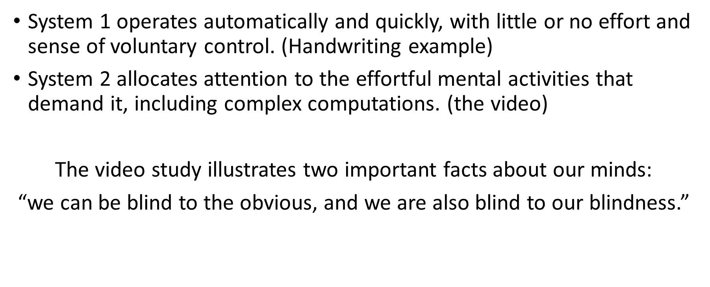
Thinking Fast and Slow
Two systems at work in our minds

Slide 30
Thinking Fast and Slow
Another example of how the mind works
Find a partner and one of you read the following to them:
I cnduo't bvleiee taht I culod aulaclty uesdtannrd waht I was rdnaieg. Unisg the icndeblire pweor of the hmuan mnid, aocdcrnig to rseecrah at Cmabrigde Uinervtisy, it dseno't mttaer in waht oderr the lterets in a wrod are, the olny irpoamtnt tihng is taht the frsit and lsat ltteer be in the rhgit pclae.
Now switch roles and the other person reads the following:
The rset can be a taotl mses and you can sitll raed it whoutit a pboerlm. Tihs is bucseae the huamn mnid deos not raed ervey ltteer by istlef, but the wrod as a wlohe. Aaznmig, huh? Yaeh and I awlyas tghhuot slelinpg was ipmorantt! See if yuor fdreins can raed tihs too.
Notes:
Do in pairs. Find a partner. One person reads the first paragraph. Switch roles. The second person reads the 2nd paragraph

Slide 31
Last Exercise
We have asked for two volunteers to demonstate this exercise with you:
Here is your task: name the colors of the following words.
DO NOT read the words...rather, say the color of the words.
For example, if the word "BLUE" is printed in a red color, you should say "RED". Please say the colors as fast as you can.

Slide 32
RED | BLUE | GREEN | BLUE | BLACK
YELLOW | GREEN | ORANGE | GREEN | RED
PINK | BLACK | BROWN | YELLOW | GRAY
BLUE | RED | GREEN | PINK | BROWN
ORANGE | BLACK | BLUE | GREEN | RED

Slide 33
RED | BLUE | GREEN | BLUE | BLACK
YELLOW | GREEN | ORANGE | GREEN | RED
PINK | BLACK | BROWN | YELLOW | GRAY
BLUE | RED | GREEN | PINK | BROWN
ORANGE | BLACK | BLUE | GREEN | RED

Slide 34
Now you try it
Please find a partner – one will read the first slide the other the second
Here is your job: name the colors of the following words.
DO NOT read the words...rather, say the color of the words.
For example, if the word "BLUE" is printed in a red color, you should say "RED". Please say the colors as fast as you can.

Slide 35
RED | BLUE | GREEN | BLUE | BLACK
YELLOW | GREEN | ORANGE | GREEN | RED
PINK | BLACK | BROWN | YELLOW | GRAY
BLUE | RED | GREEN | PINK | BROWN
ORANGE | BLACK | BLUE | GREEN | RED

Slide 36
RED | BLUE | GREEN | BLUE | BLACK
YELLOW | GREEN | ORANGE | GREEN | RED
PINK | BLACK | BROWN | YELLOW | GRAY
BLUE | RED | GREEN | PINK | BROWN
ORANGE | BLACK | BLUE | GREEN | RED

Slide 37
Questions – thoughts . . .

Slide 38
The Costs of Stereotypes
“No single piece of evidence can be decisive in response to a complex issue such as this one . . .”
Dr. Male makes an incorrect assumption about a female patient’s health.
Job search experiments, where female names replaced male names to measure advocacy of candidates.
The cost of black – white stereotypes.
Gender – career tests regarding stereotyping.
The cost of PWI – HBCU stereotypes
Having an all white male department
Notes:
For extension:
Having concerns about hiring a black extension educator to work in a predominantly white county
Having an all white male extension board
For COA
The cost of PWI – HBCU stereotypes
Having an all white male department

Slide 39
One last video
Where are you from?
https://www.youtube.com/watch?v=DWynJkN5HbQ

Slide 40
Reflection
In your small groups please discuss – you will only share what you choose
Nothing new about this information.
Okay, made me consider/think about . . .
Just more “being politically correct” talk.
Might be useful because . . .
Other thoughts?

Slide 41
Diversity Learning Opportunity
To continue your personal diversity development
Harvard Implicit Bias Project:
https://implicit.harvard.edu/implicit/takeatest.html
There are a dozen of these tests under the Project Implicit project with Harvard University (Weight – Religion)
Totally voluntary!

Slide 42
In conclusion
Thanks
We hope this was a brave place to learn and share.
Hidden bias is complicated – takes many forms as we experienced today.
There are opportunities to continue to grow and expand our thinking – Project Implicit is just one example.
Thanks for your candor, trust and participation.

Slide 43
Resources
Places to go and discover
https://www.youtube.com/watch?v=tMkNgcgJbCg
Yale Public Heath Study, Levy, Zonderman, Slade, 2009. Study took into account factors such as depression, smoking and family history
http://www.cnn.com/2015/11/24/living/implicit-bias-tests-feat/
Whistling Vivaldi, Claude Steele,
Thinking Fast and Slow, Daniel Kahneman
BlindSpot, Mahzarin Banaji, Anthony Greenwald
Microaggressons in Everyday Life, Derald Wing Sue
Kirwan Institute, Ohio State University, http://kirwaninstitute.osu.edu/

Slide 44
Next Event
Rainbow Callout
  9/11/19 at 6pm in PMU ballrooms
Talk and Tea
  9/26 at 12:00pm in WSLR 116
Woke Olympics and Social Justice Arrogance
  9/25 at 4pm in AGAD 225

Slide 45
