Slide 1
Plant and Animal-Based Proteins: Economic Implications for the U.S. Agricultural Sector
Nathan Thompson
Department of Agricultural Economics, Purdue University

Slide 2
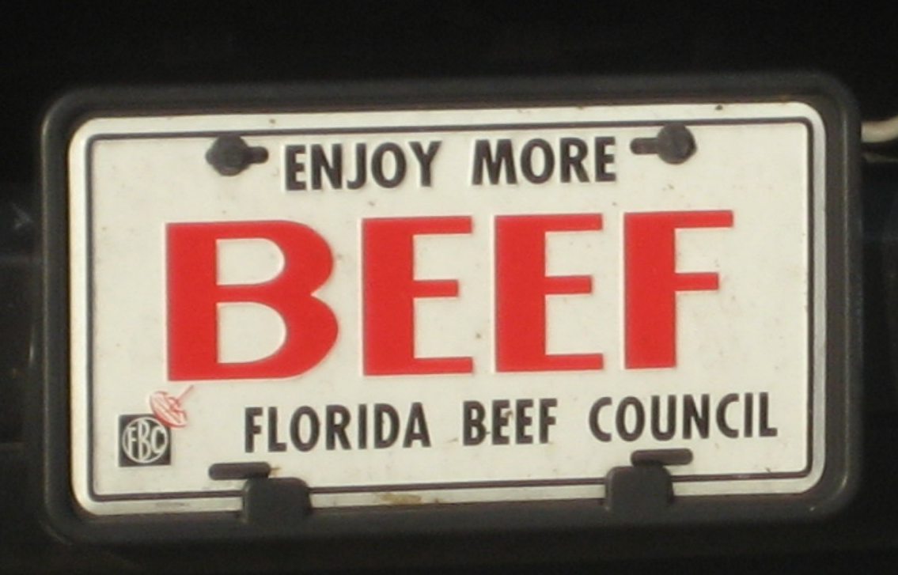
My own personal biases

Slide 3
The truth is somewhere in the middle…

Slide 4
Who’s investing?

Slide 5
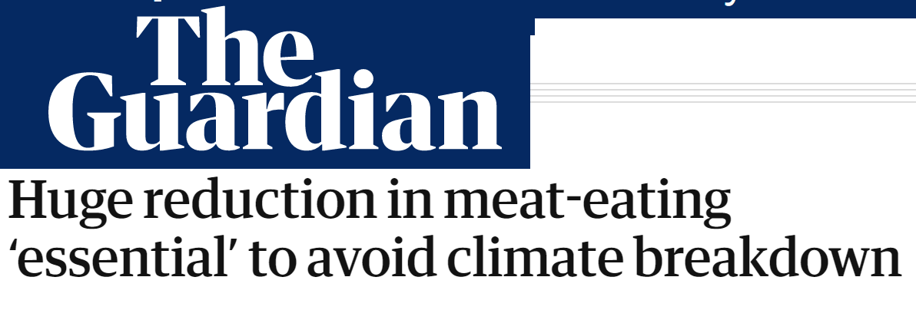
Some people want to end animal agriculture.

Slide 6
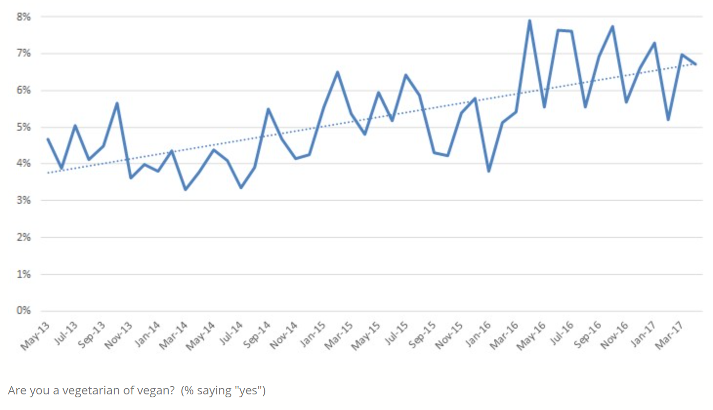
US proportion of vegetarians and vegans
Source: http://jaysonlusk.com/blog/2017/7/26/trends-in-animal-welfare-concerns-and-meat-demand

Slide 7
US meat consumption
Source: USDA Economic Research Service

Slide 8
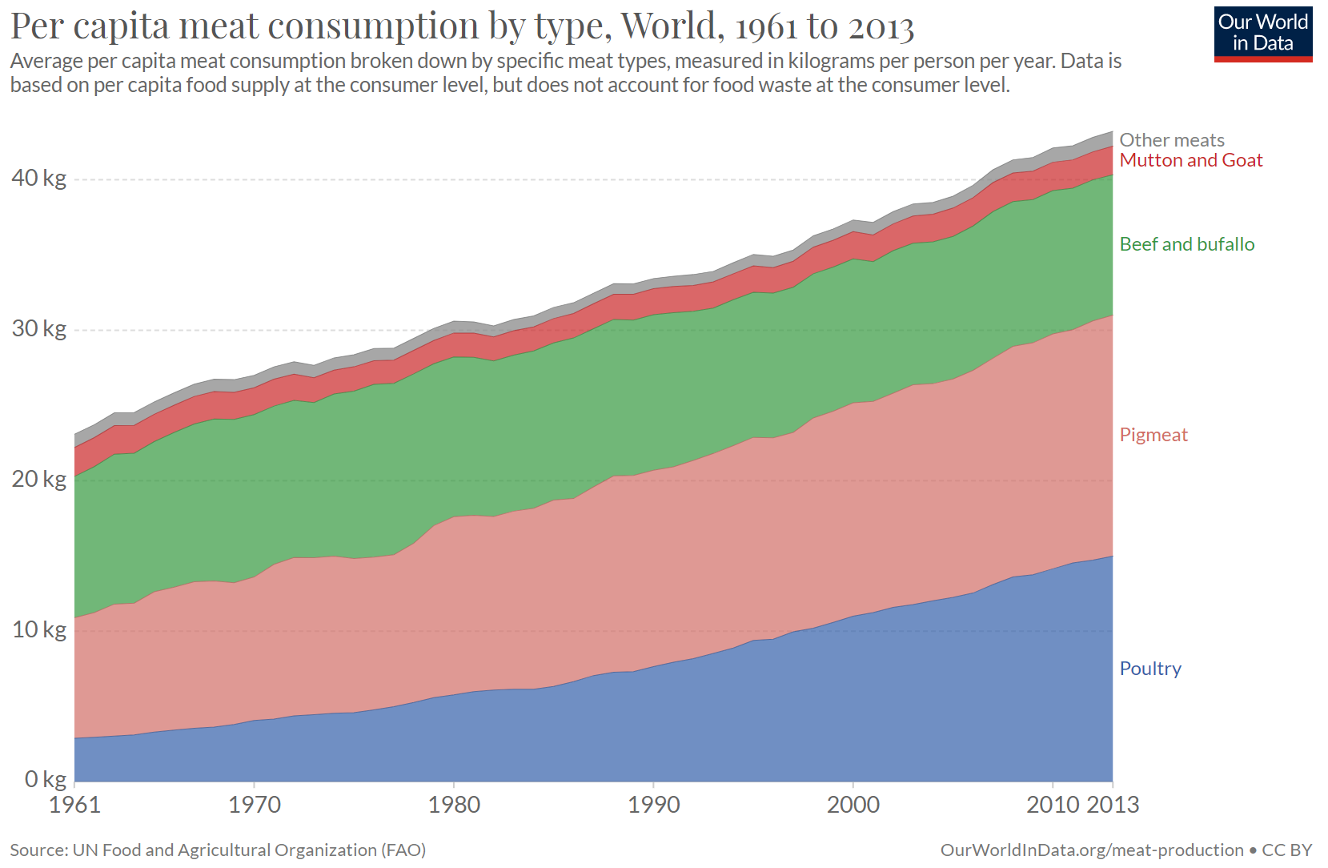
Global meat consumption

Slide 9
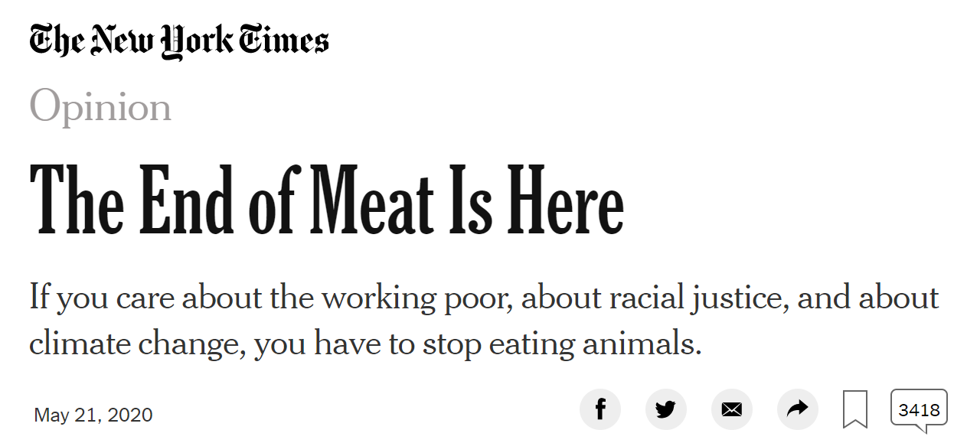
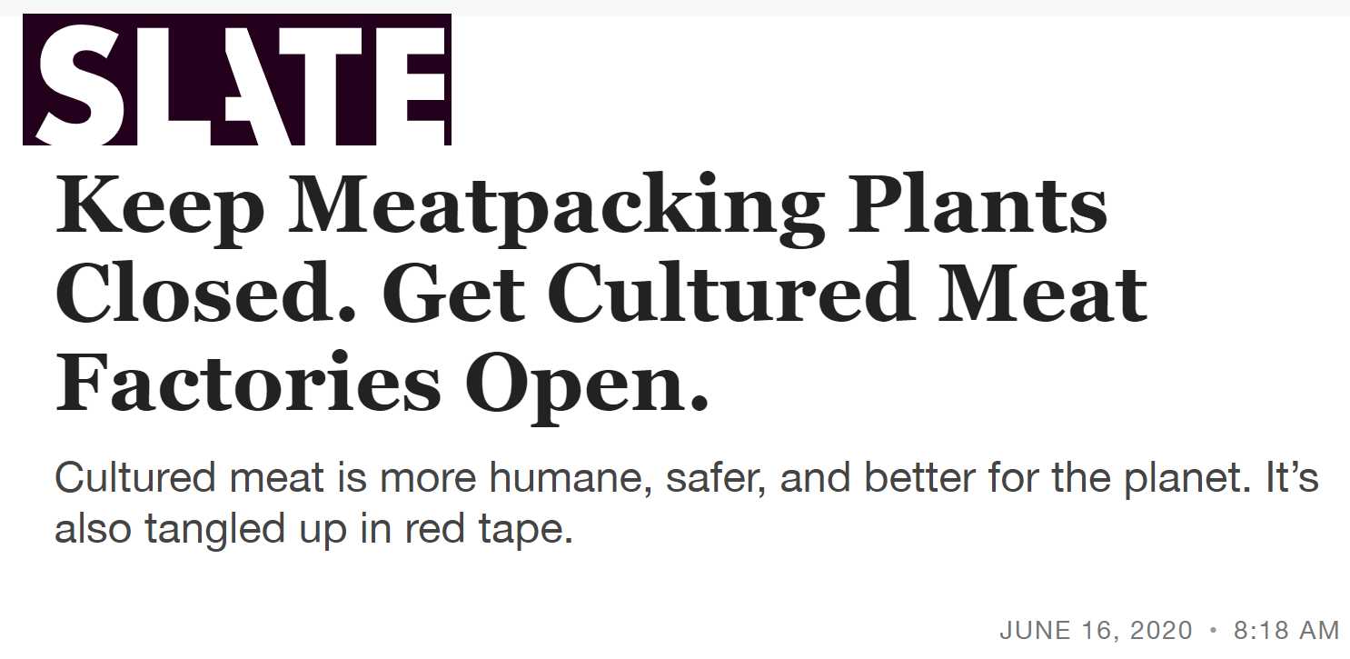
COVID-19 impact

Slide 10
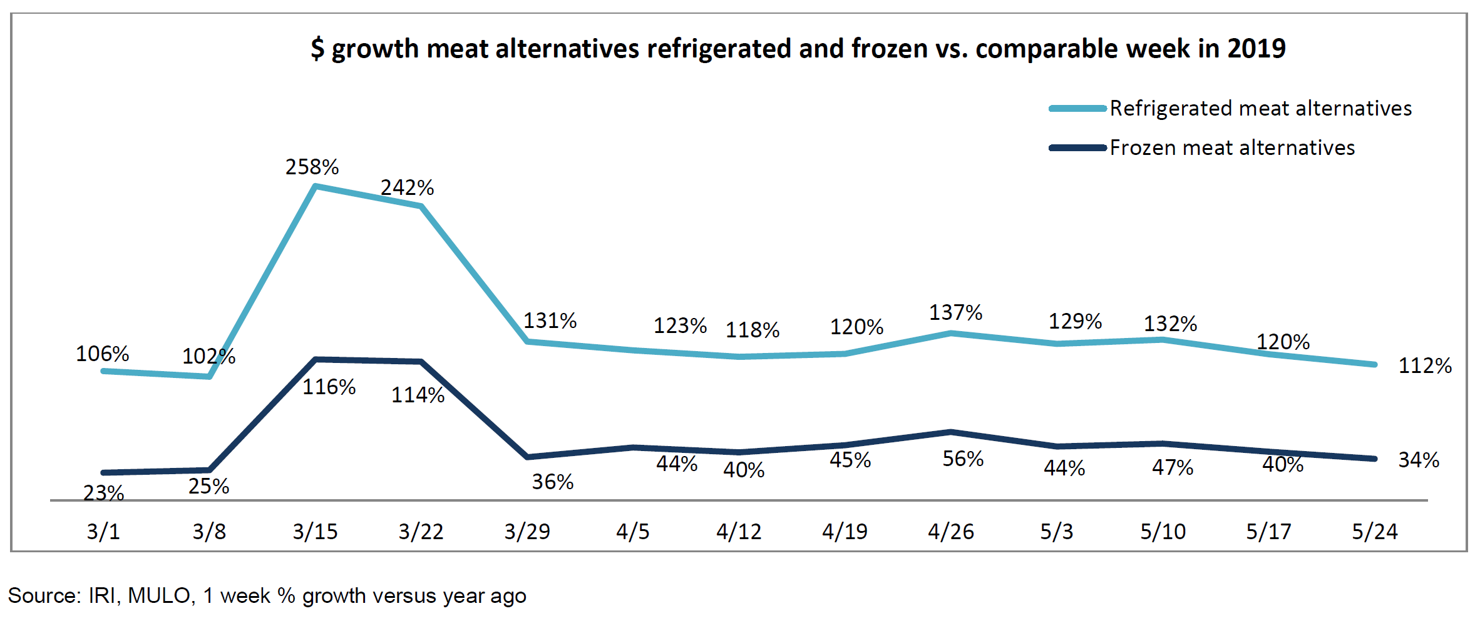
Plant-based meat sales growth during COVID-19

Slide 11
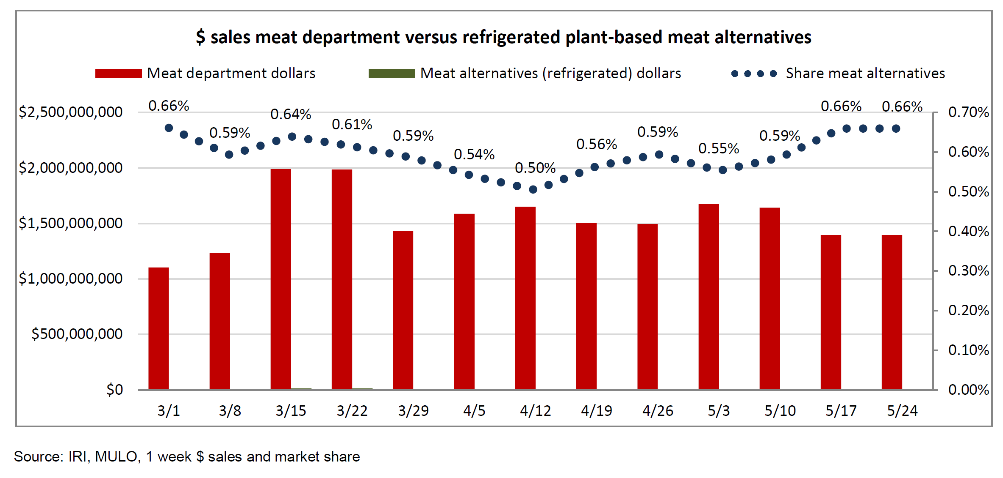
Plant-based meat market share

Slide 12
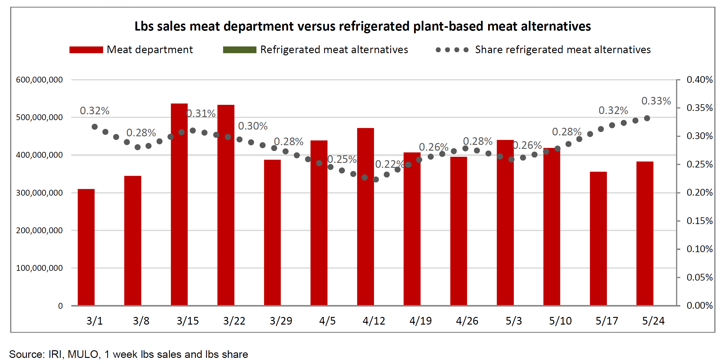
Plant-based meat market share

Slide 13
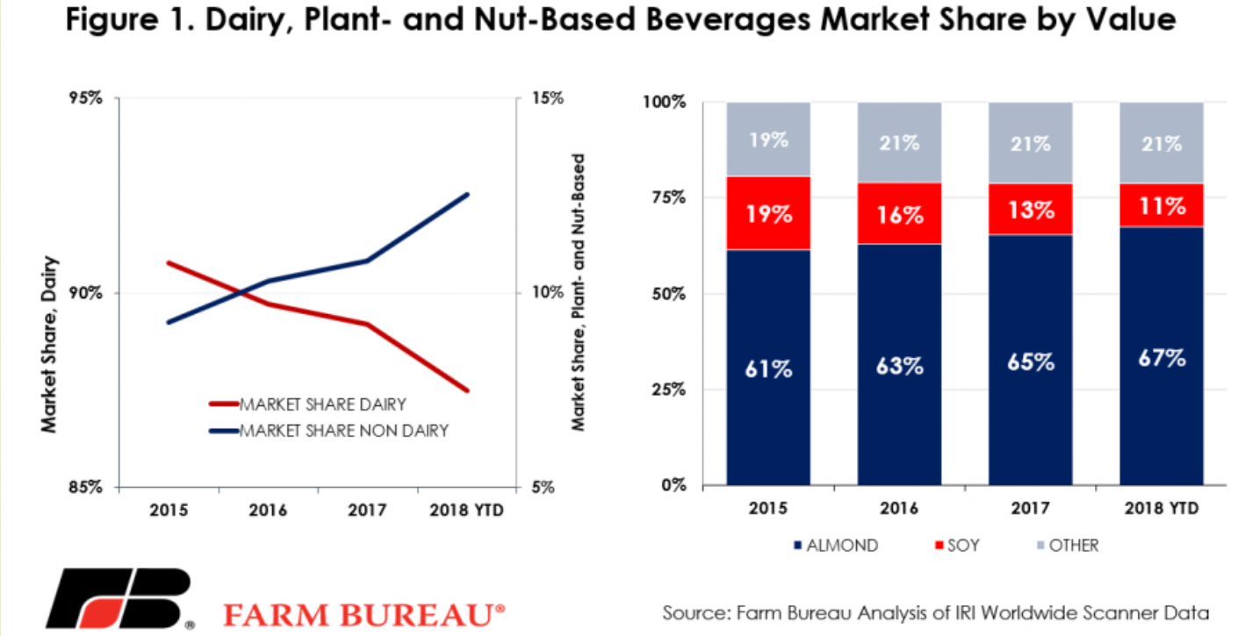
Lessons from dairy

Slide 14
How should animal agriculture respond?
Should you advocate for their industry?
Be transparent
Tell your story
Listen
Should you run out and “educate” consumers?
Condescending
Defensive
Does not include listening

Slide 15
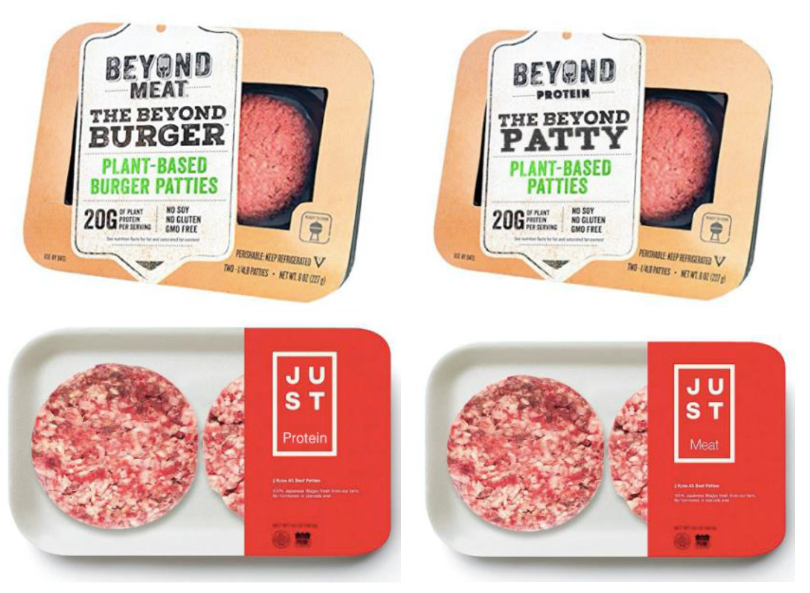
How should animal agriculture respond?
Labeling initiatives?
Does not change buying behavior
Costly
Source: DeMuth, B. 2019. https://d.lib.msu.edu/etd/47846

Slide 16
How should animal agriculture respond?
Continue working to improve efficiency/sustainability

Slide 17
US beef production vs. beef cow inventory, 1970-2019
Source: USDA National Agricultural Statistics Service

Slide 18
Global beef production vs. beef cow inventory, 2019
Source: USDA Foreign Agricultural Service

Slide 19
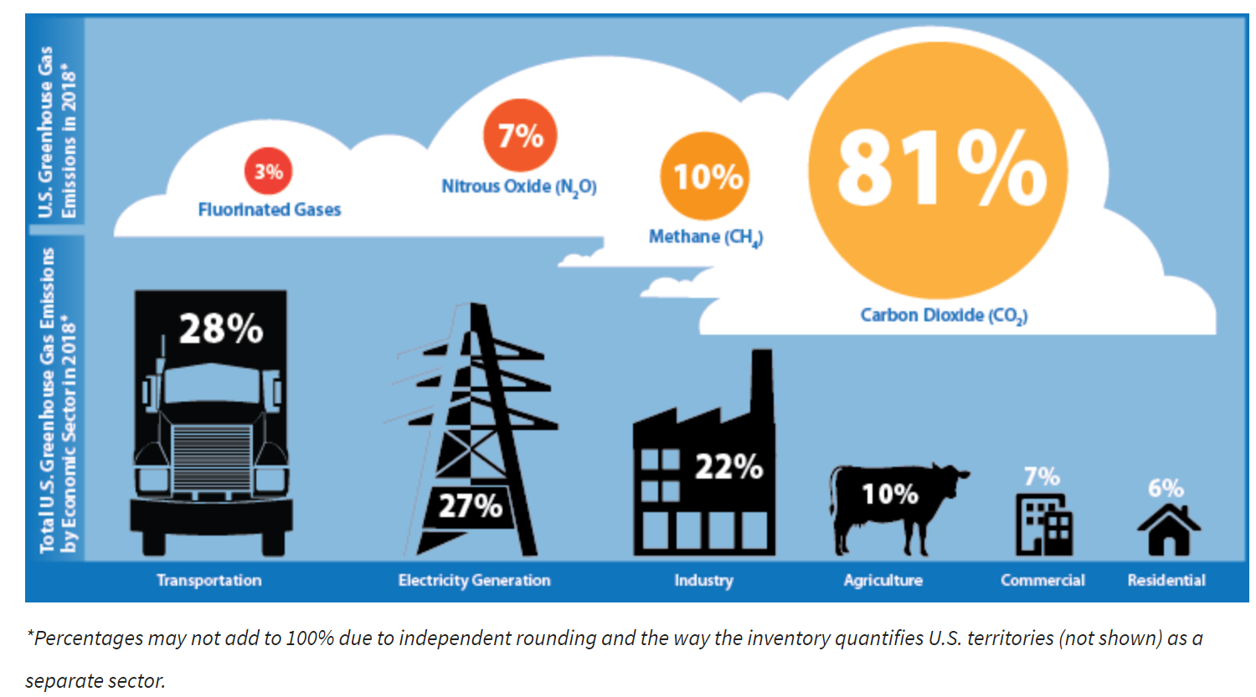
US GHG Emissions

Slide 20
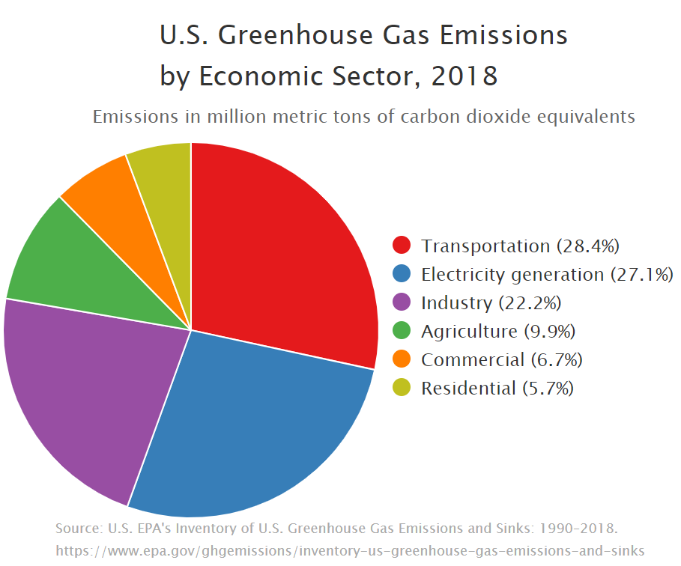
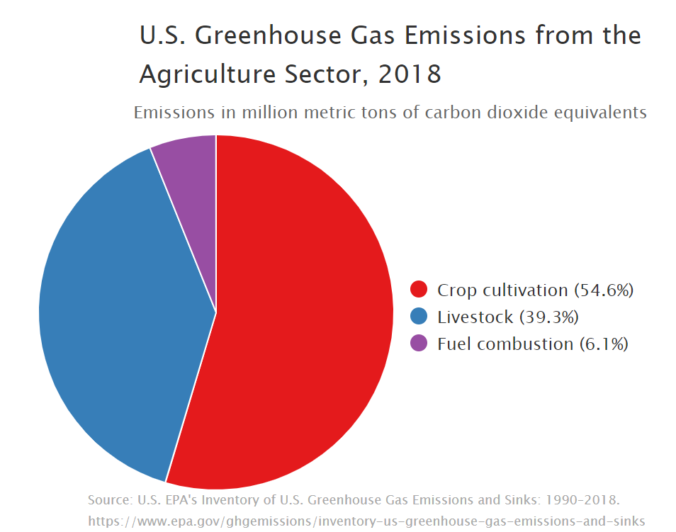
US GHG Emissions
All livestock are responsible for 3.9% of US GHG emissions

Slide 21
US average retail ground beef price
Current Beyond Meat Price
Source: U.S. Bureau of Labor Statistics

Slide 22
Opportunity for US crop producers?
Pea protein (Beyond)
Soy protein (Impossible)
Wheat protein

Slide 23
US dry pea acres
Dry pea acres needed to produce enough protein for 12 billion lbs. of plant-based meat
US dry pea acres
Source: USDA NASS; personal calculations

Slide 24
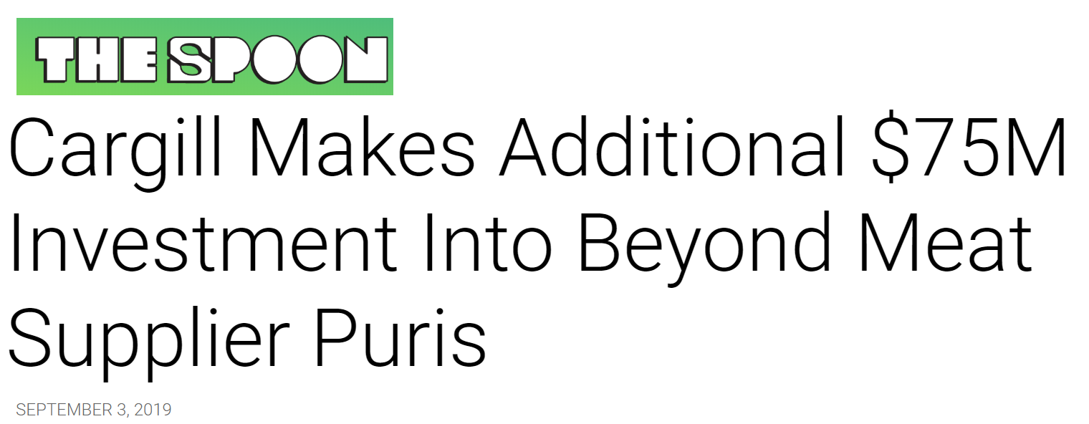
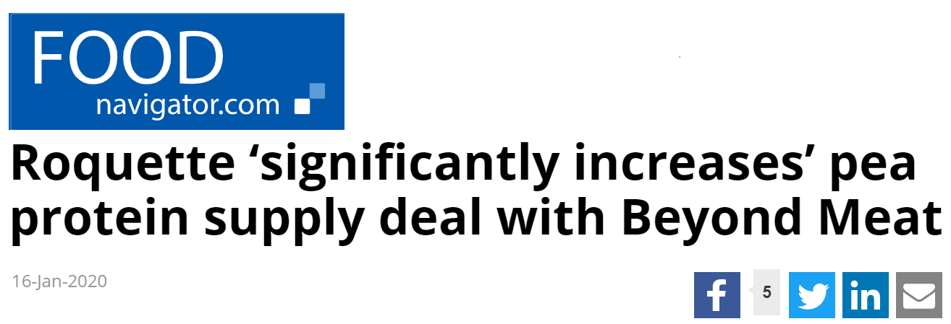
Implications for US crop producers
May be short-run opportunities
Sourcing pea protein from outside of the US

Slide 25
US soybean acres
US soybean acres
Soybean acres needed to produce enough protein for 12 billion lbs. of plant-based meat
Source: USDA NASS; personal calculations

Slide 26
Implications for US crop producers
May be short-run opportunities
Food grade soybeans
Non-GMO
Organic
This is not the next “China” in terms of soybean demand
Net negative impact

Slide 27
Thank you! Nathan Thompson 765-494-0593 thomp530@purdue.edu

