Slide 1
Renewable Energy in Indiana
Paul V. Preckel, Faculty Director
State Utility Forecasting Group
Purdue University
Presented to:
Farm Policy Study Group
July 7, 2020

Slide 2
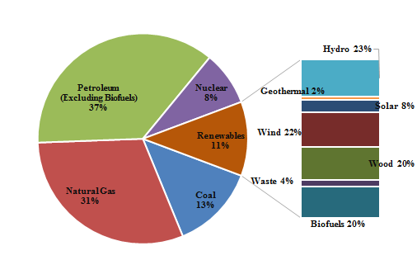
2018 U.S. Energy Consumption by Source
Source: EIA

Slide 3
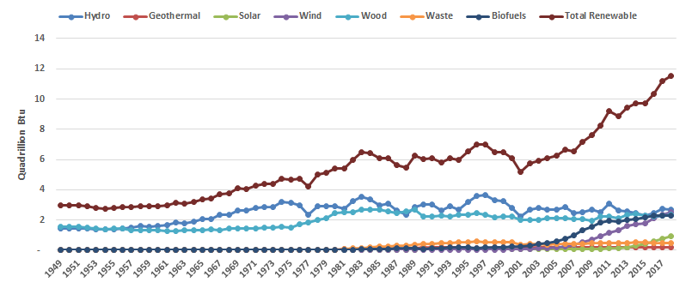
Historical Renewable Energy in the U.S.
Source: EIA

Slide 4
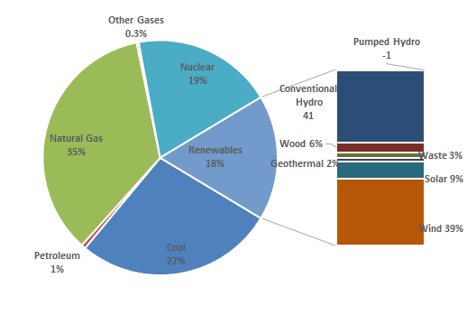
2018 U.S. Electricity Generation by Energy Source
Source: EIA

Slide 5
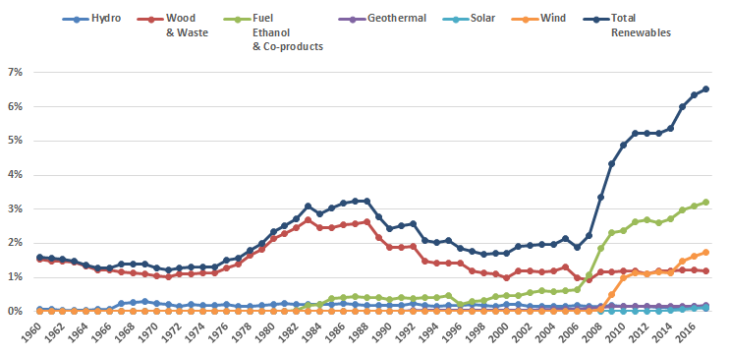
Renewables Share of Indiana Total Energy Consumption
Source: EIA

Slide 6
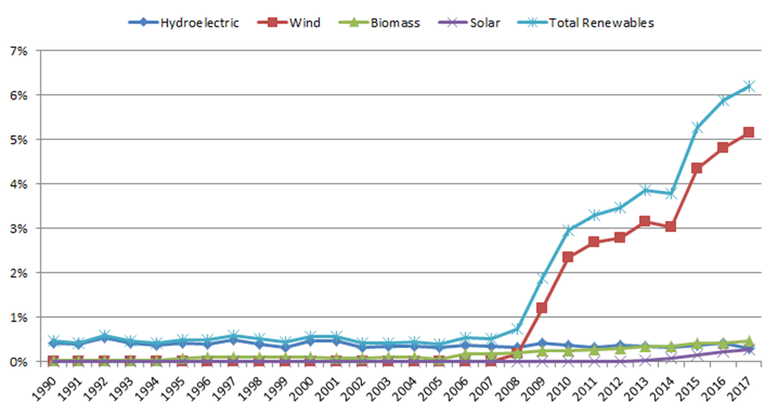
Renewables Share of Indiana Electricity Generation
Source: EIA

Slide 7
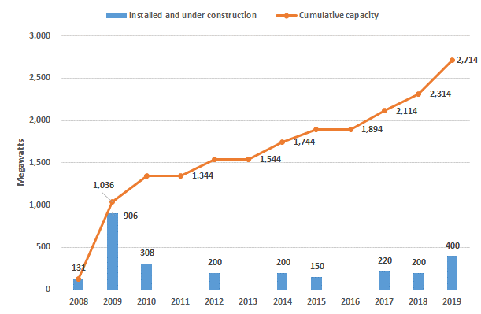
Indiana Wind Capacity
Over 2.7 GW of capacity online by the end of the year
IRPs indicate over 5 GW of additional wind in preferred portfolios
Sources: IURC, EIA

Slide 8
Photovoltaics
There is an estimated 322 MW of PV capacity in Indiana, almost all of it installed in the last six years
Continued growth of utility scale PV is indicated
utility IRPs include over 7,000 MW of future PV additions in preferred portfolios
PV costs have decreased by over 60% since 2010

Slide 9
Indiana Perspective
Indiana Generation Capacity – 25GW (Peak Demand 19GW)
Wind 2.7GW existing; 7GW tentatively planned
Solar PV 0.3GW existing; 7GW tentatively planned
Capacity credit varies by technology (Wind is 8-14% and Solar is about 50%)
Indiana Electricity Pricing (2017): Res. 11.8¢/kWh, Com. 9.6¢/kWh, Ind. 7.8¢/kWh
Notes:
Indiana 2019 population 6.7 million
Average persons per household 2.5
Indiana 2019 households 2.5 million
(Source U.S. Census)

Slide 10
Indiana Perspective (cont’d.)
Indiana 2019 population 6.7 million
Average persons per household 2.5
Indiana 2019 households 2.5 million (Source U.S. Census)
Average generation capacity per household 10kW (loose upper bound)
Average 2017 electricity generation per household 12,600kWh (12.6MWh)

Slide 11
Why the Shift to Renewables?
Falling capital costs + low operating and maintenance costs
Levelized Cost of Energy (LCOE) incorporates both costs
Policy – Renewable Portfolio Standards

Slide 12
Wind & Solar Competitive (EIA)

Slide 13
Renewable Portfolio Stds. (EIA)

Slide 14
Issues as Penetration Grows
Not all power sources are equal
Dispatch-ability – absent economical, utility scale storage, and load must equal generation moment to moment
Reliability – how much of capacity can be relied upon when needed? (Don’t forget capacity credit!)

Slide 15
Policy Issues
Generation portfolio mix – reliability, cost, resilience
Many Federal incentives are expiring
Some less generous ones remain
Indiana net metering expires after June 30, 2022
Other less generous Indiana incentives remain
NIPSCO feed-in tariffs available in their service area

Slide 16
Further Information
State Utility Forecasting Group
765-494-4223
www.purdue.edu/discoverypark/SUFG/
Paul Preckel
765-494-4240
preckel@purdue.edu

Slide 17
Wind/Solar Incentives Expiring
Federal – Expire December 31, 2019:
Production Tax Credit
Business Energy Tax Credit
MACRS (accelerated depreciation)

Slide 18
Continuing Incentives
Federal
USDA REAP (grants and loan guarantees up to 25% of project costs)
QECBs (tax credit bonds)
USDA High Energy Cost Grant Program (any applicable areas in Indiana?)
Residential Renewable Energy Tax Credit (tax credit of 30% of allowable costs)
DOE Loan Guarantee Program

Slide 19
Continuing Incentives (cont’d.)
Indiana
Net Metering Rule (If installed by June 30, 2022, retail credit until July 1, 2047; if installed after June 30 2022 1.25 utility's average wholesale cost)
Renewable Energy Property Tax Exemption
Sales and Use Tax Exemption for Electrical Generating Equipment (only clear for wind)
Clean Energy Portfolio Goal

Slide 20
Continuing Incentives (cont’d.)
Utility
NIPSCO feed-in tariff (for 15 years with payment determined by based size of project and availability of subsidy in tiers)
Impending COVID-19 Stimulus Package could possibly change the story

Slide 21
Organic Waste Biomass
Until the recent increase in ethanol production, this resource was the largest source of renewable energy in Indiana
Now third behind biofuels and wind
It is the 2nd largest source of renewable electricity generation in the state
Landfill gas (71 MW)
Animal waste biogas (20 MW)
Wastewater treatment (195 kW)

Slide 22
Hydroelectric Power
Until expansion of wind energy beginning in 2008, hydroelectricity was the largest source of renewable electricity in Indiana
Now third behind wind and biomass
The 88 MW project at the Cannelton Locks on the Ohio River was completed in 2016
Most of the output goes to utilities outside Indiana

Slide 23
Dynamics of LCOE (Lazard, 2019)

